Slide 1


FAP 12 (for KLMP, R&T blocks)
Back of T block
T
P
FAP 13 (for ABC blocks)
Covered walkway towards Vanbrugh
T/019
T/213
TnS Staff
T/105
T/205
L
M
T/231
A
Walmgate
Stray /
Wentworth
Way
M/023
M/049
M/052
T/005
T/101
SAS Rec
Vanburgh College
R/216
K/018
B
R
K
Con
NatSci
HoD
K/157A
K/227
B/002
Cookies
TF YSBL
R/112
R/212
R/012
B/006
B/103
R/015
The Department of Biology
Fire Assembly Points
Wkshps
I
E
C
F
D
Lakeside
Entrance
H
Infra
H/102
Stores
J
Q
Q/014
Paleo Hub
FAP 11 (for DEFGHIQJ blocks)
Car Park G next to Q block
Environment

Slide 2
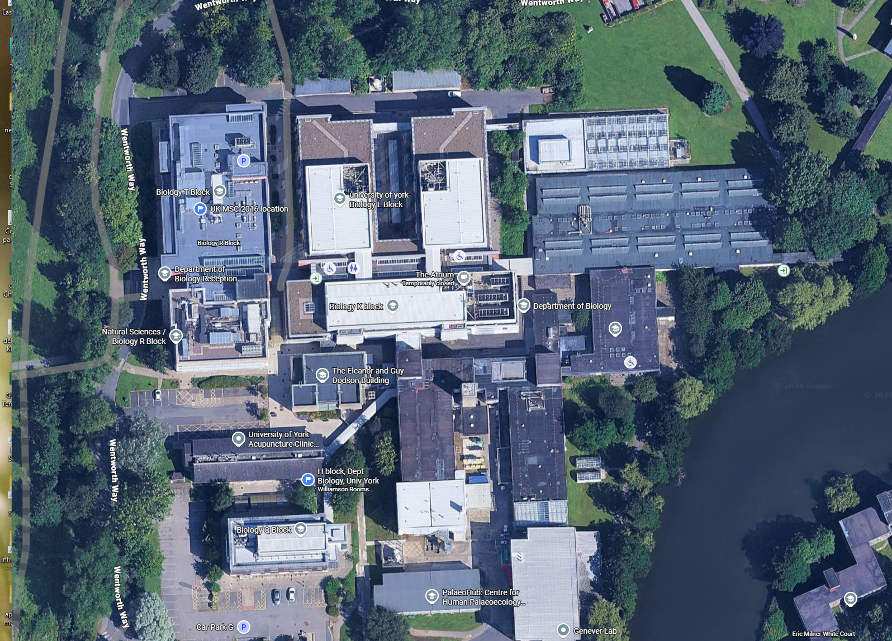
FAP 12 (for KLMP, R&T blocks)
Back of T block
FAP 13 (for ABC blocks)
Covered walkway towards Vanbrugh
FAP 11 (for DEFGHIQJ blocks)
Car Park G next to Q block

